Slide 1

action
history
DEPI Graduation Project
insights
Analyze
After edit
about
Data Analysis CAI1_DAT2_G3e

Slide 2





01
OUR TEAM
02
Kerolos Reda
04
Michael Alfons
03
05
Menna Mohammed
Naglaa Fathy
Taghreed Attia

Slide 3






AGENDA T I M E L I N E
about
Goal & business questions
Data exploration
Cleaning
and preparation
Data
analysis
present insights
Recommendations

Slide 4
Project goal
action
Analyze
history
insights
After edit
The project aims to analyze the performance of countries in the FIFA World Cup, focusing on key metrics such as match outcomes, goals scored, player performance, and group stage rankings. It will track World Cup tournaments over the years, examining trends such as how host countries perform, factors influencing team success, and the relationship between FIFA rankings and match outcomes. The project will also delve into individual player statistics like caps, goals scored, and the influence of domestic clubs on international performance.
about

Slide 5
Business Questions
Total Goals Scored by Country: What is the total number of goals scored by each country across all World Cup tournaments?
Total Matches Played by Country: How many matches have been played by each country in World Cup tournaments?
Average Goals per Match: What is the average number of goals scored per match for each team?
Top 5 Goal Scorers: Who are the top 5 goal scorers across all World Cup tournaments? How many goals did they score?
Performance of Host Countries: How do host countries perform compared to non-host countries? What is the win/loss ratio of host countries?
Impact of Domestic League on Player Performance: What is the relationship between the strength of domestic leagues (based on club rankings) and player performance (goals, assists, etc.) in the World Cup?
Average Age of Players by Stage: What is the average age of players in the group stage, knockout stage, and finals of the tournament?
Total Caps by Country: What is the total number of international caps (matches played) for players in each country during World Cup tournaments?
about

Slide 6
Business Questions
Top 5 Countries by Goals Conceded: Which countries have conceded the most goals during the World Cup?
Success Rate of Teams in Group Stage: What percentage of teams from each group advance to the knockout stage?
Correlation between FIFA Ranking and Goals Scored: Is there a significant correlation between a country's FIFA ranking and the number of goals it scores?
Player Performance by Domestic Club: Which domestic clubs contribute the most players to the World Cup, and how do those players perform (goals, assists, match wins)?
Loyal Players: Which players have participated in more than one World Cup tournament? How many such players exist for each country?
Goals by Position: What is the total number of goals scored by defenders, midfielders, and forwards for each country?
history
about

Slide 7


Row data summary before editing
Extent of variability and diversity of the dataset
After edit
history
about
6
32
19,619
5
FILES
COLUMNS
ROWS
Data types
World_cups
World_cup_groups
Wc_squads
2022_Wc_matches
Wc_matches
intern_matches
Nominal
Ordinary
Numerical
Date
String

Slide 8
Cleaning and preparation
All missing values were handled by AI and have been validated
added a new columns
winner team, Host country win ,home team win
Normalization
Duplicate
Formatting errors
Analyze
teams
After edit
Missing Values
Enhance
“2022_world_cup_matches” Rows 50 : 65 corrected to the actual team names. Corrected typos and syntax errors in players’ names and club names
Dealing with columns containing binary data, highlight the team captain for each squad
No duplicates found

Slide 9
Analysis using Excel and DAX
Data modeling
Measures
Calculated tables
Calculated columns
history
insights
Analyze
After edit
about

Slide 10
insights
DATA MODELING
Analyze

Slide 11
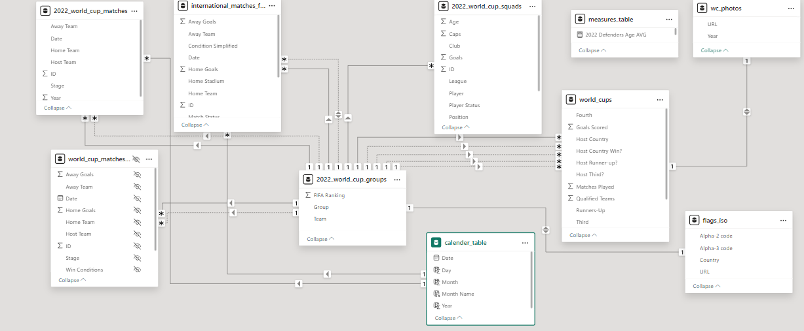

Slide 12
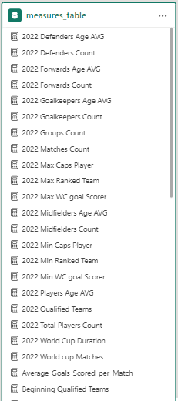
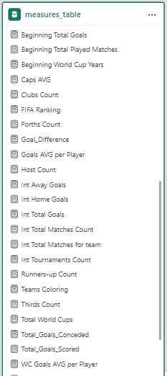
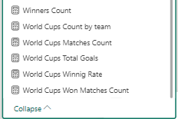
Measures

Slide 13
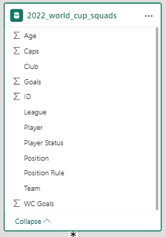
Measures extracted from this table
2022 Defenders Age AVG: Average of wc 2022 Defender players age.
2022 Defenders Count: Count of wc 2022 Defender players.
2022 Forwards Age AVG: Average of wc 2022 forward players age.
2022 Forwards Count: Count of wc 2022 forward players.
2022 Goalkeepers Age AVG: Average of wc 2022 Goalkeeper players age.
2022 Goalkeepers Count: Count of wc 2022 goalkeeper players.
2022 Max Caps Player: Maximum number of matches players played with national team.
2022 Max WC goal Scorer: First player in total wc goals.
2022 Midfielders Age AVG: Average of wc 2022 Midfielder players age.
2022 Midfielders Count: Count of wc 2022 Midfielder players.
2022 Min Caps Player: Minimum number of matches players played with national team.
2022 Min WC goal Scorer: Last player in total wc goals.
2022 Players Age AVG: Average of wc 2022 players ages.
Caps AVG
Clubs Count
Goals AVG per Player

Slide 14
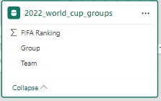







Measures extracted from this table
2022 Groups Count
2022 Max Ranked Team: First ranked team by FIFA.
2022 Min Ranked Team: Last ranked team by FIFA.
2022 Qualified Teams: Total number of qualified teams in wc 2022.
2022 Total Players Count: Total number of participated players in wc 2022.
FIFA Ranking
Winners Count

Slide 15
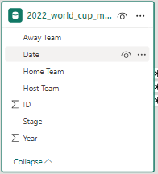
Measures extracted from this table
2022 Matches Count: Count of wc 2022 matches.
2022 World Cup Duration: Duration of wc 2022 tournament in days.

Slide 16
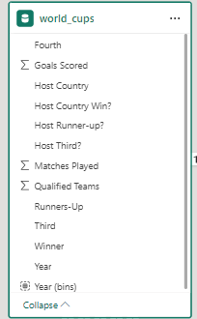







Measures extracted from this table
2022 World cup Matches
Beginning Qualified Teams: Count of team participated in wc form the start of tournament.
Beginning Total Goals: Total number of goals in wc form the start of tournament.
Beginning Total Played Matches: Total number of matches in wc form the start of tournament.
Beginning World Cup Years
Host Count
Total World Cups
World Cups Winnig Rate

Slide 17
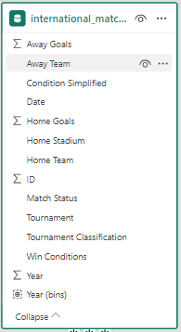


Measures extracted from this table
Int Away Goals: Total number of international goals scored by away teams.
Int Home Goals: Total number of international goals scored by home teams.
Int Total Goals: Total number of international goals.
Int Total Matches Count: Count of international matches.
Int Tournaments Count: Count of international tournaments.
Int Total Matches for team

Slide 18
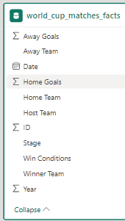
Measures extracted from this table
Total_Goals_Conceded
Total_Goals_Scored
World Cup Matches Count: Total number of played matches in wc tournaments.
World Cup Total Goals: Total number of goals in wc tournaments
World Cups Won Matches Count

Slide 19
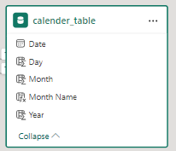
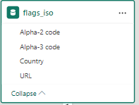
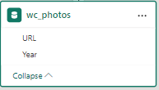
Calculated tables

Slide 20
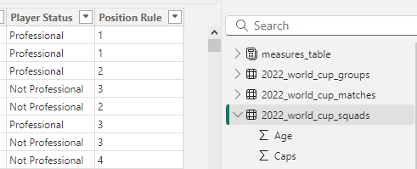
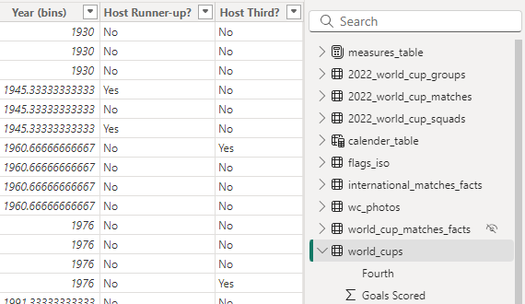
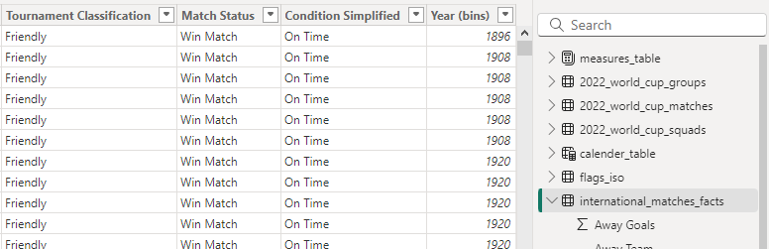
CALCULATED COLUMNS

Slide 21
Visualization and story telling
action
insights
history
Analyze
Dashboard & insights
After edit
about

Slide 22
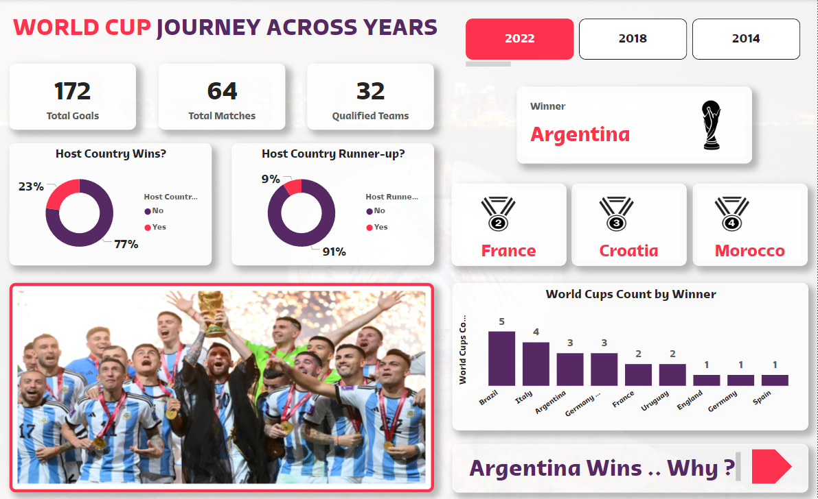

Slide 23
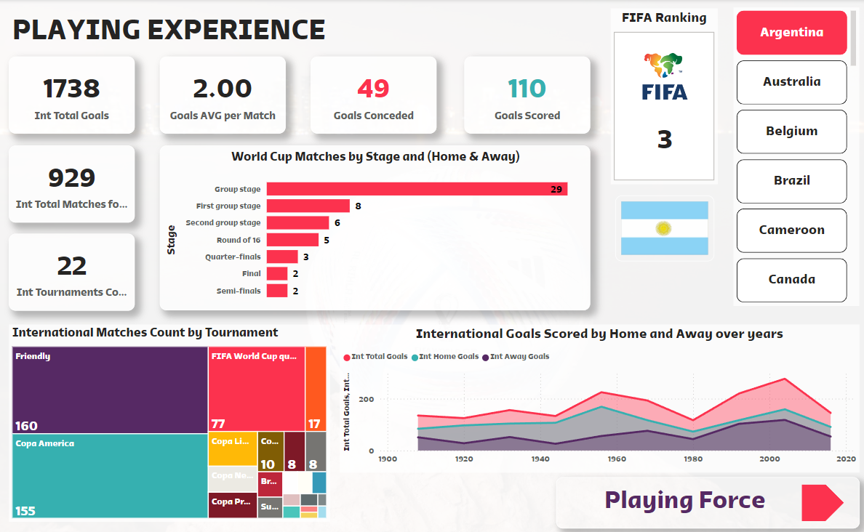

Slide 24
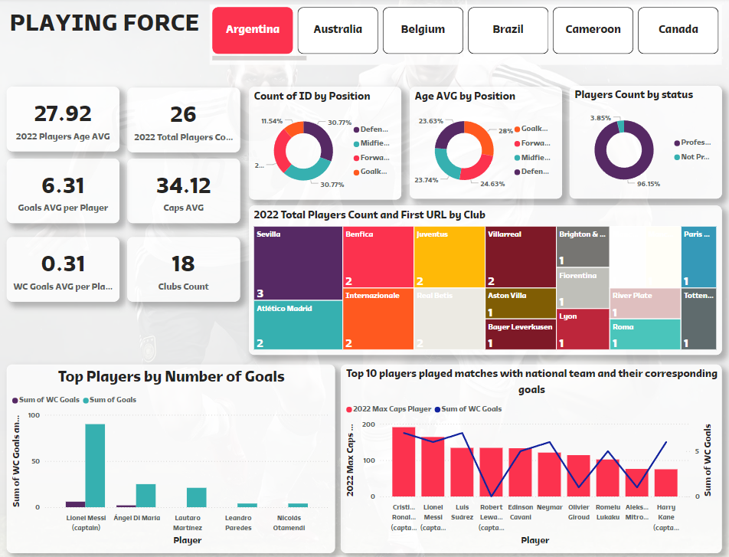
Analyze
history
After edit
about

Slide 25



Top Performers
Domestic Leagues and Player Performance
A few countries, including Brazil, Germany, and Italy, dominate the World Cup in terms of wins and overall performance. These countries consistently reach the advanced stages of the tournament, demonstrating that a combination of player experience, team cohesion, and preparation leads to success.
Players from stronger domestic leagues tend to perform better in international tournaments. Teams with a higher concentration of players from top-tier clubs (like those in Europe) tend to advance further in the tournament due to better preparation and exposure to high-level competition.
FIFA Ranking and Success
Group Stage Performance
There is a moderate correlation between a country's FIFA ranking and its success in the World Cup. Top-ranked teams generally perform better, but there are occasional surprises where lower-ranked teams outperform expectations, highlighting the unpredictability of tournament play
Teams that perform well in the group stage tend to carry their momentum into the knockout rounds. Consistency in the early stages is a strong indicator of success in the later stages of the tournament.
action
insights
Analyze
Average Age of Players
Loyal and Experienced Players
Teams with a balanced mix of youth and experience tend to perform better. Younger players bring energy and stamina, while older, more experienced players offer strategic thinking and leadership, particularly in knockout stages.
Teams that rely on players who have participated in multiple World Cups (loyal players) tend to perform better, as these players bring invaluable experience and composure to high-pressure matches.

Slide 26
Recommendations & Call to Action
Develop Domestic Leagues: Countries should invest in strengthening their domestic leagues, as stronger domestic leagues translate into better international performance. Actionable Step: Encourage development programs within domestic leagues to produce well-prepared, high-quality players for the national team.
Maintain a Balanced Team: Successful teams combine young talent with experienced veterans. Actionable Step: National teams should aim to scout a balance of promising young players and experienced leaders to maintain this dynamic.
action
insights
Analyze
After edit
Strategic Use of Star Players: Individual brilliance can be the deciding factor in crucial games. Actionable Step: Coaches should strategically utilize key players in high-stakes matches, ensuring they are well-rested and physically prepared for knockout games.

Slide 27
Recommendations & Call to Action
Capitalize on FIFA Ranking Momentum: Teams ranked highly by FIFA should use this as motivation and confidence going into the tournament. Actionable Step: National teams should plan and execute their strategies with the knowledge that they are among the favorites, reinforcing team confidence.
Retain Experienced Players: Having players who have participated in multiple World Cups is a huge advantage. Actionable Step: Ensure veteran players are retained in the squad for their leadership and experience, even if their role on the field is reduced.
action
insights
Analyze
After edit
Focus on Group Stage Performance: Success in the group stage is crucial for later success in the tournament. Actionable Step: Teams should treat group-stage matches with equal importance to knockout matches and aim for consistent performances throughout the tournament.

Slide 28


Any questions
2024 OCT
Microsoft power bi engineering team
Under Supervision of Eng/ Amira Shahin

